Slide 1
Student Course Management System
Complete Workflow
Accessed on github
https://github.com/sandrakawombe/Student-Course-Management-System

Slide 2
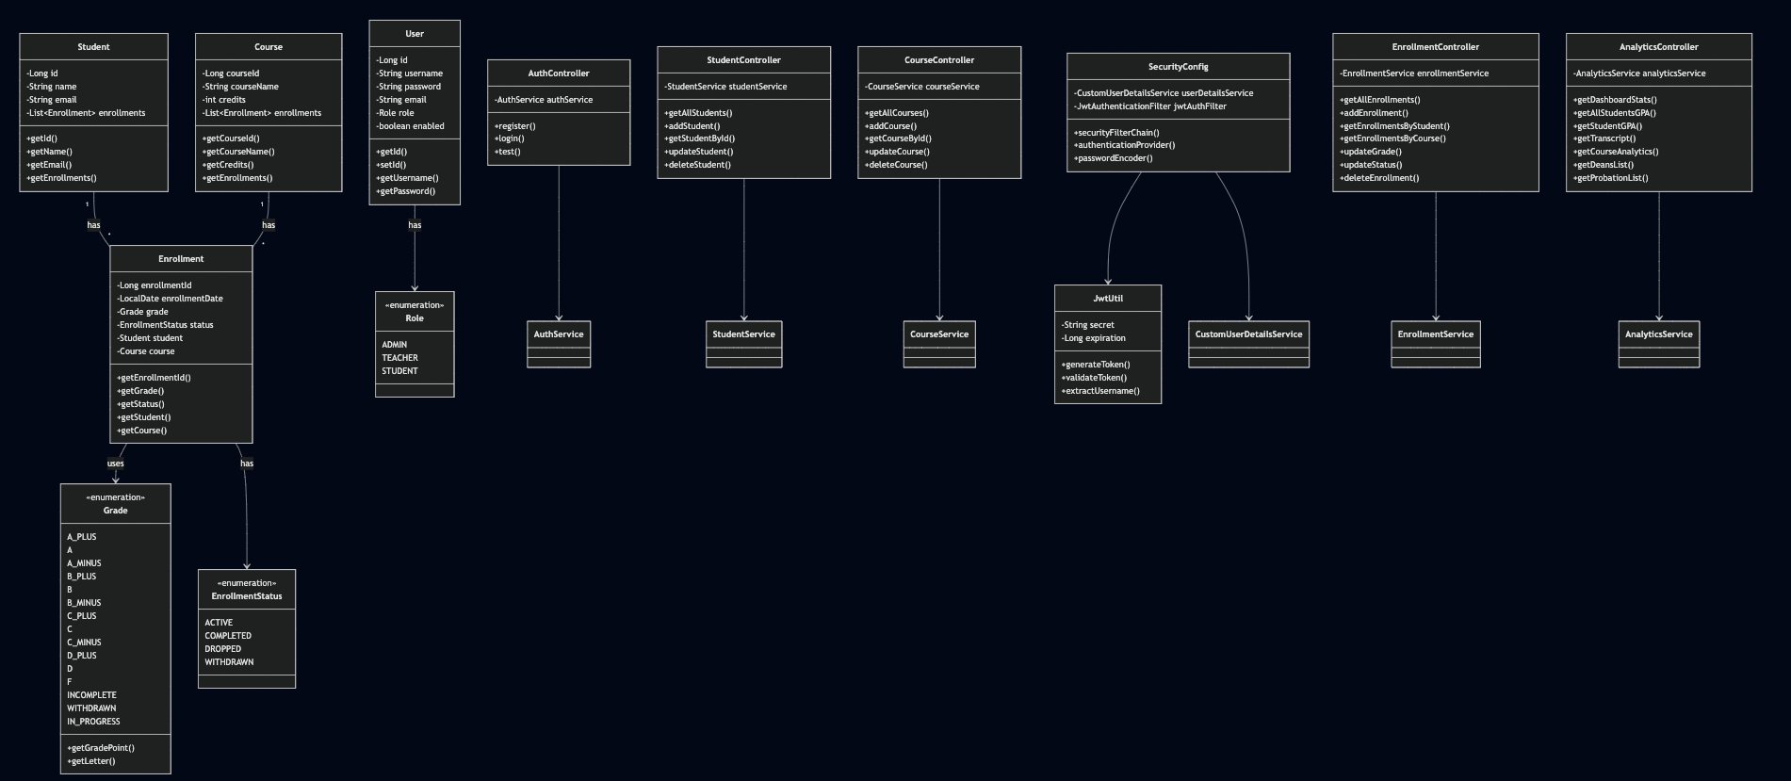
Class Diagram

Slide 3
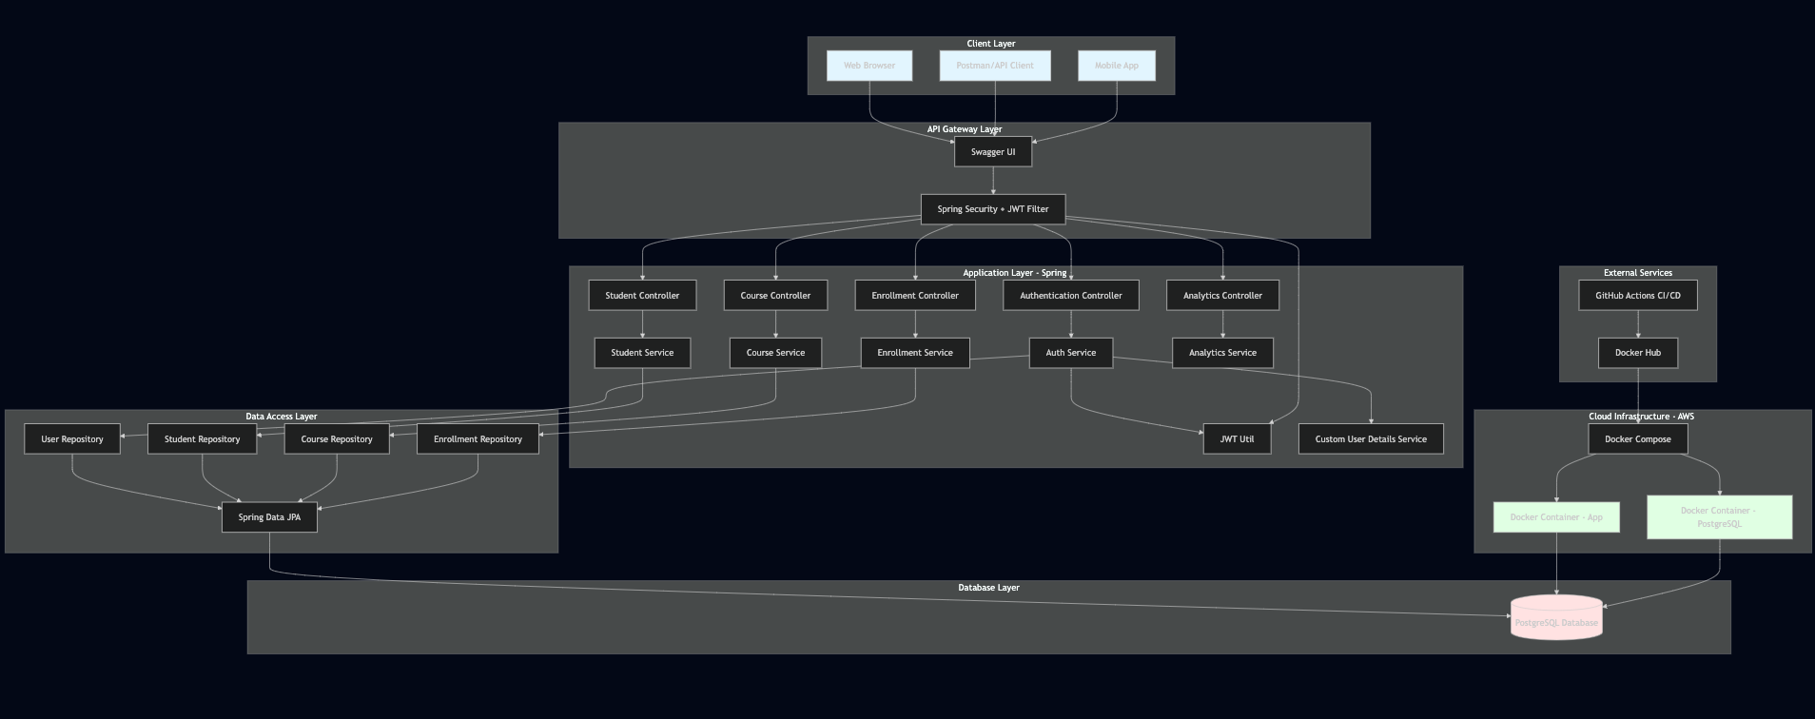
System Architecture Diagram

Slide 4
System Overview
This system manages students, courses, enrollments, and academic analytics with three user roles:
ADMIN: Full system access
TEACHER: Manage students, courses, grades
STUDENT: View their own data

Slide 5
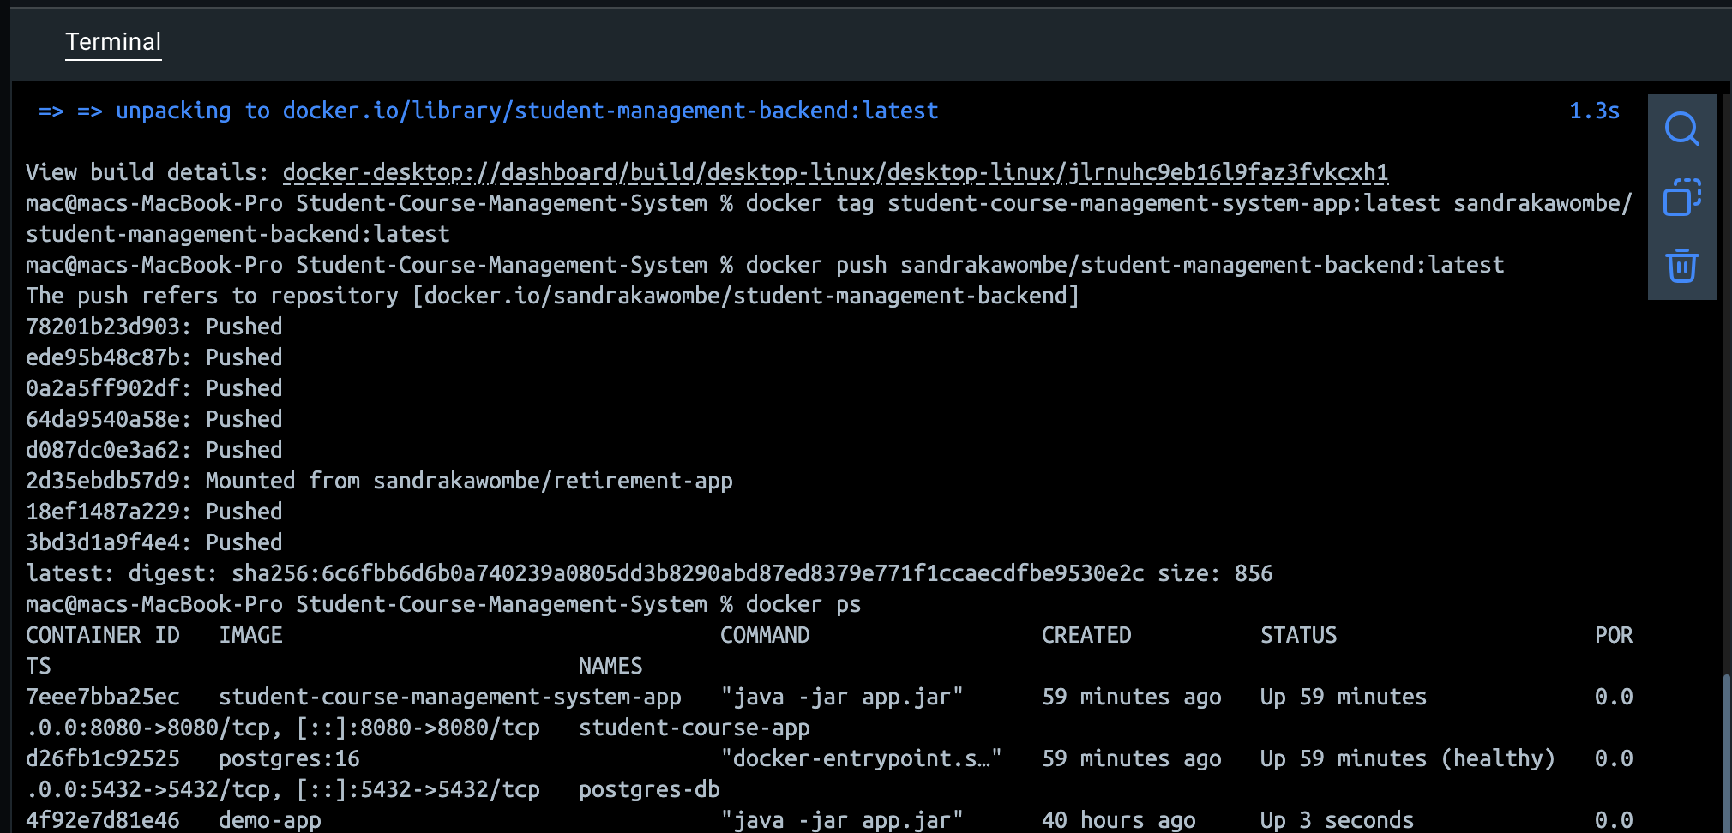
Docker Container for the Application

Slide 6
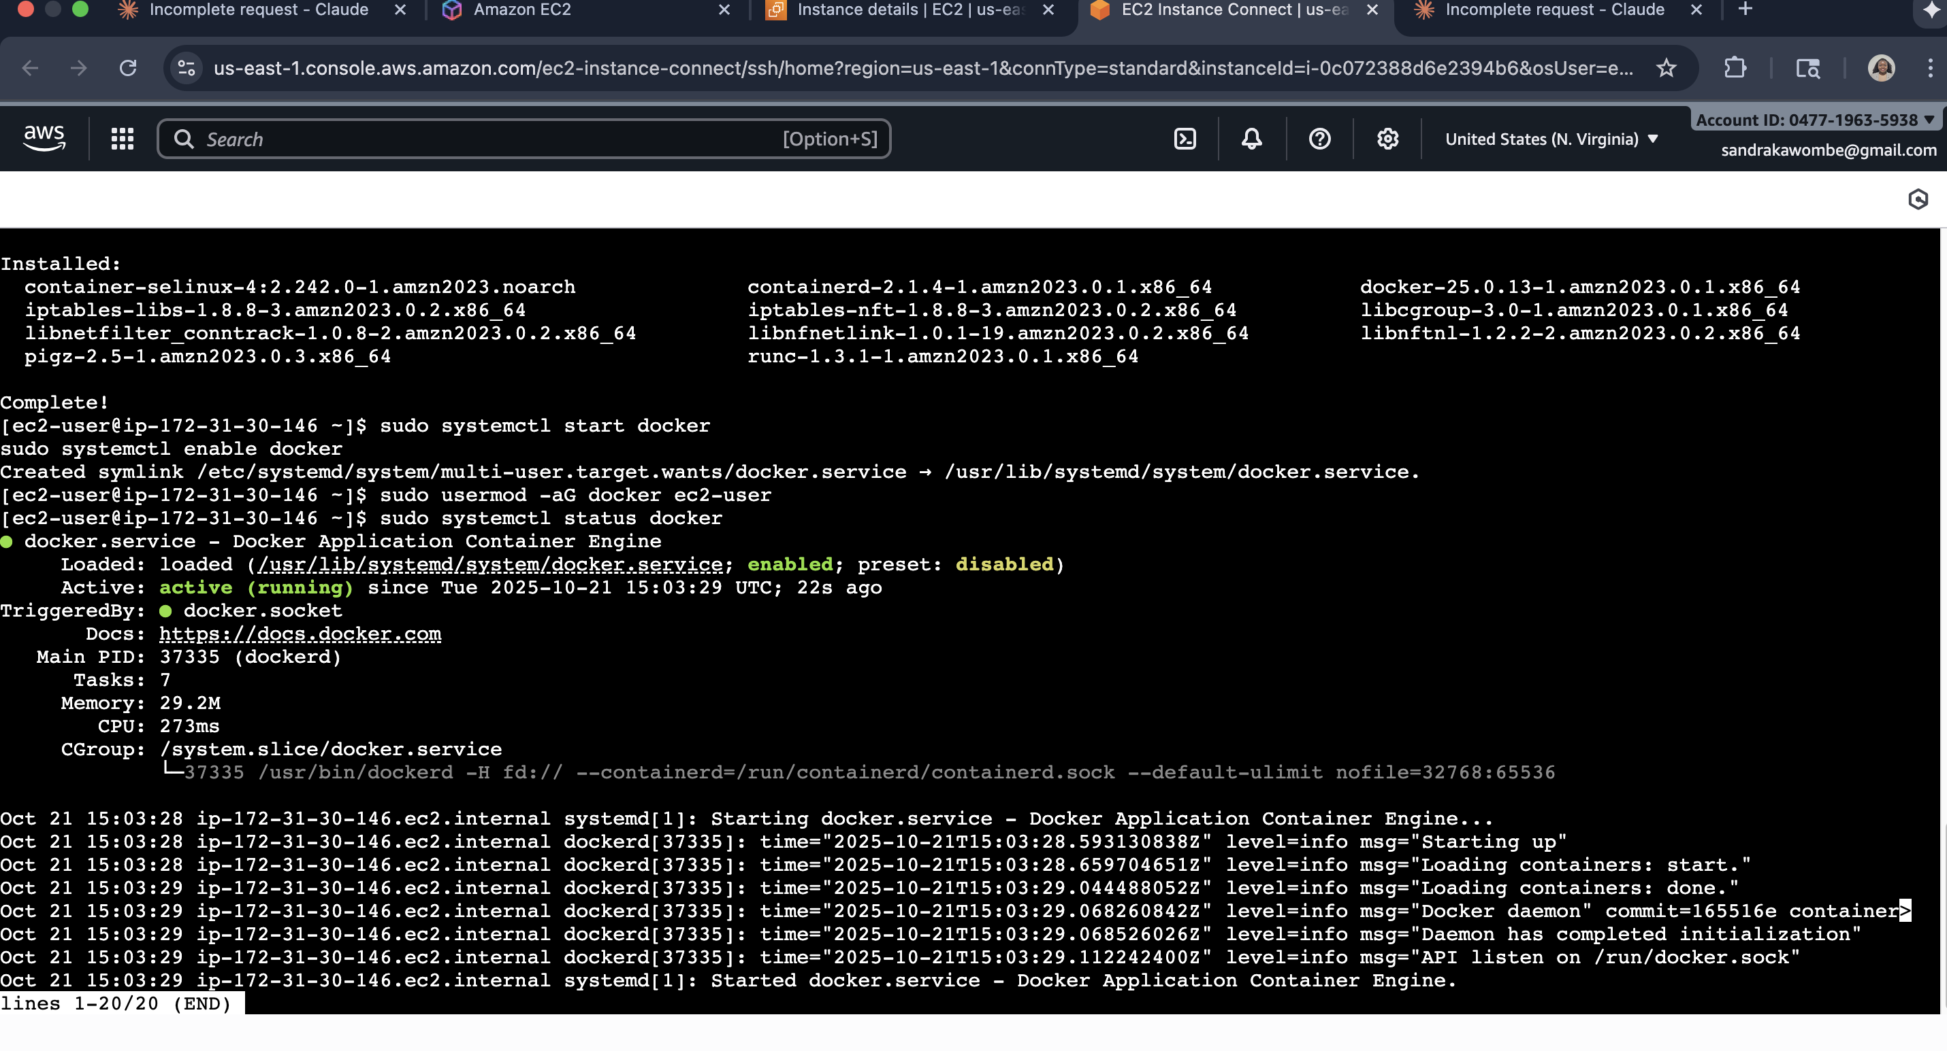
Deploy Docker on AWS

Slide 7
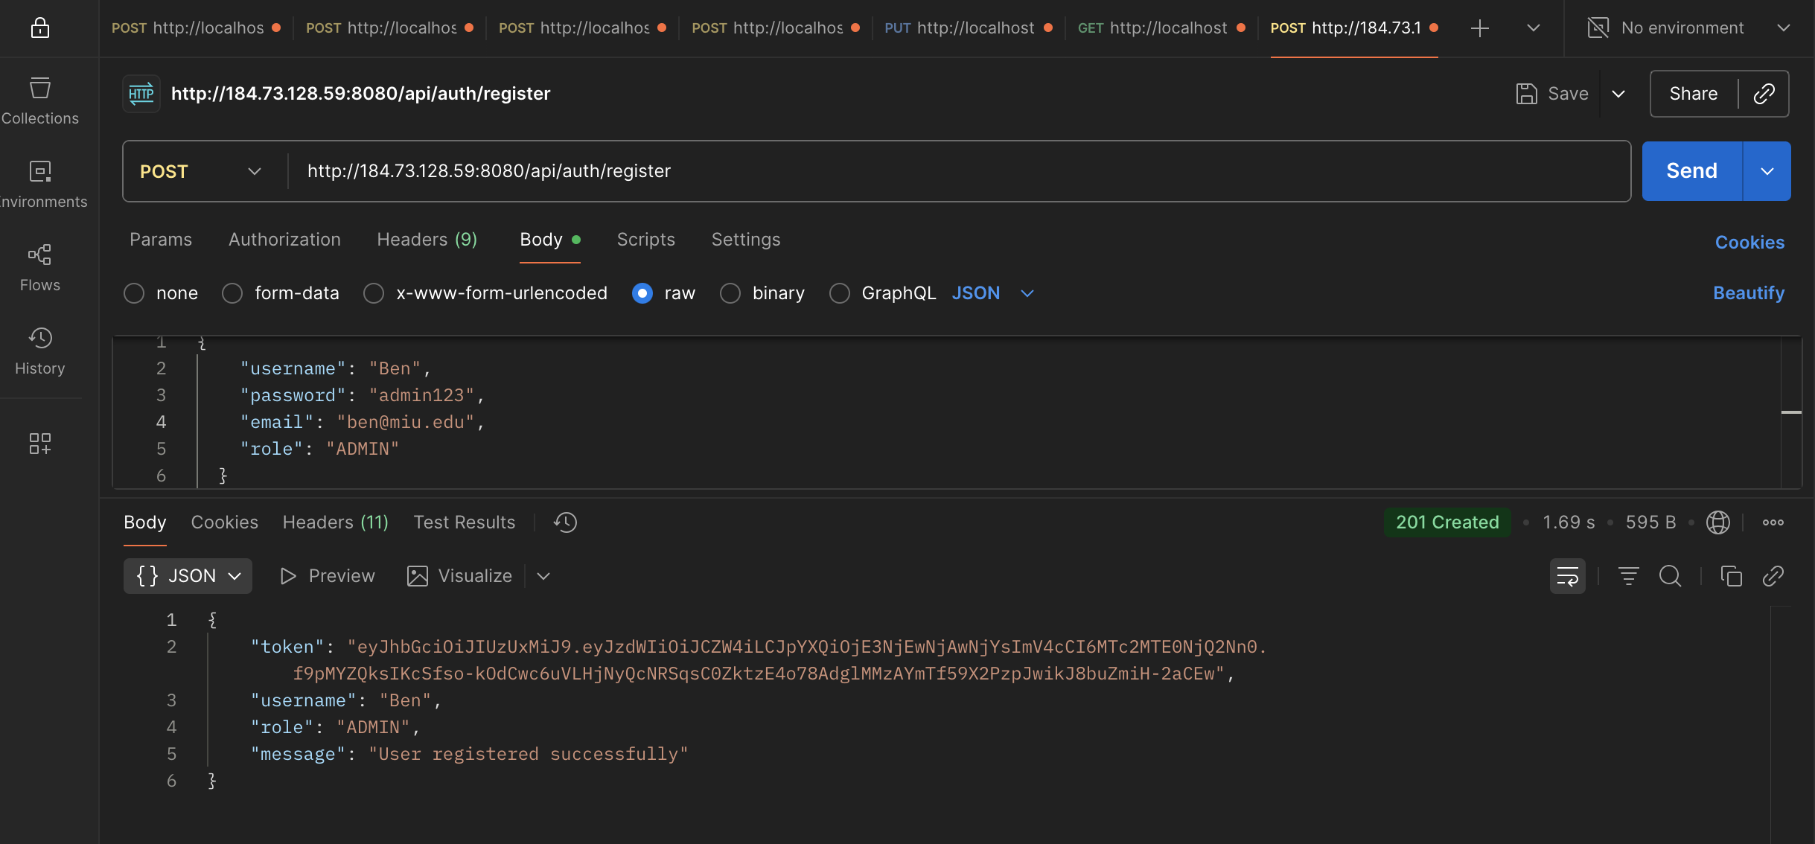
Access APIs on Via EC2 as well

Slide 8
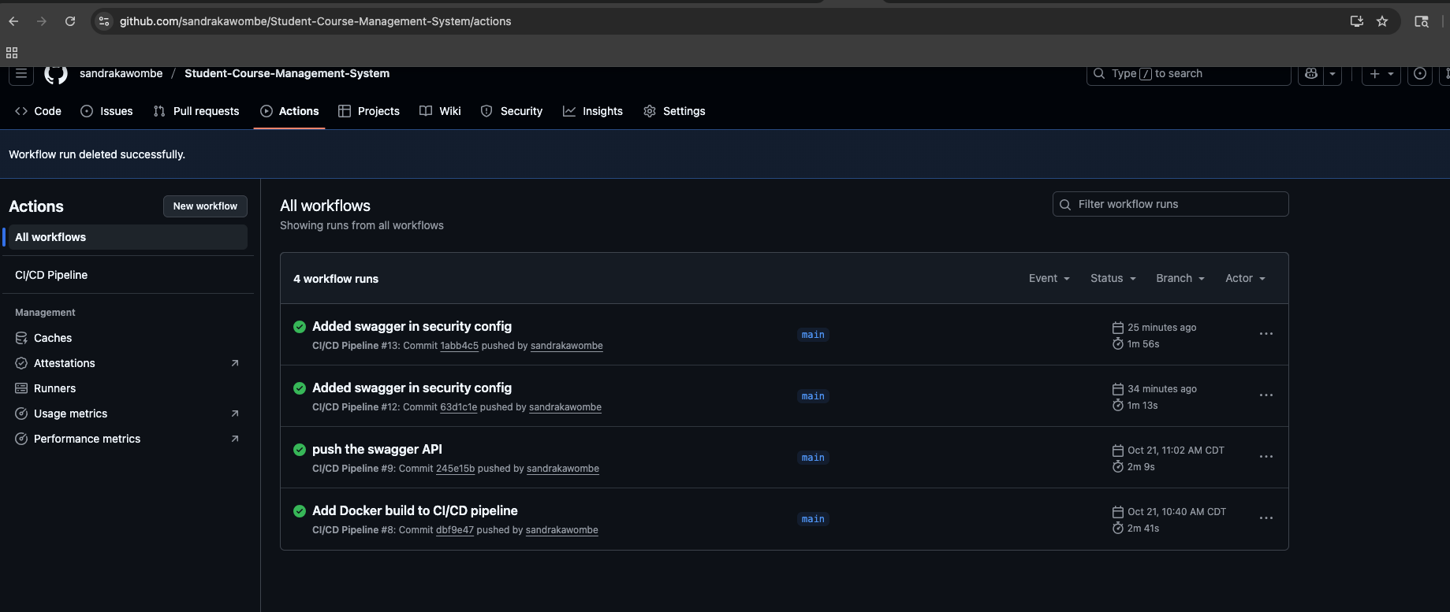
CI/CD

Slide 9
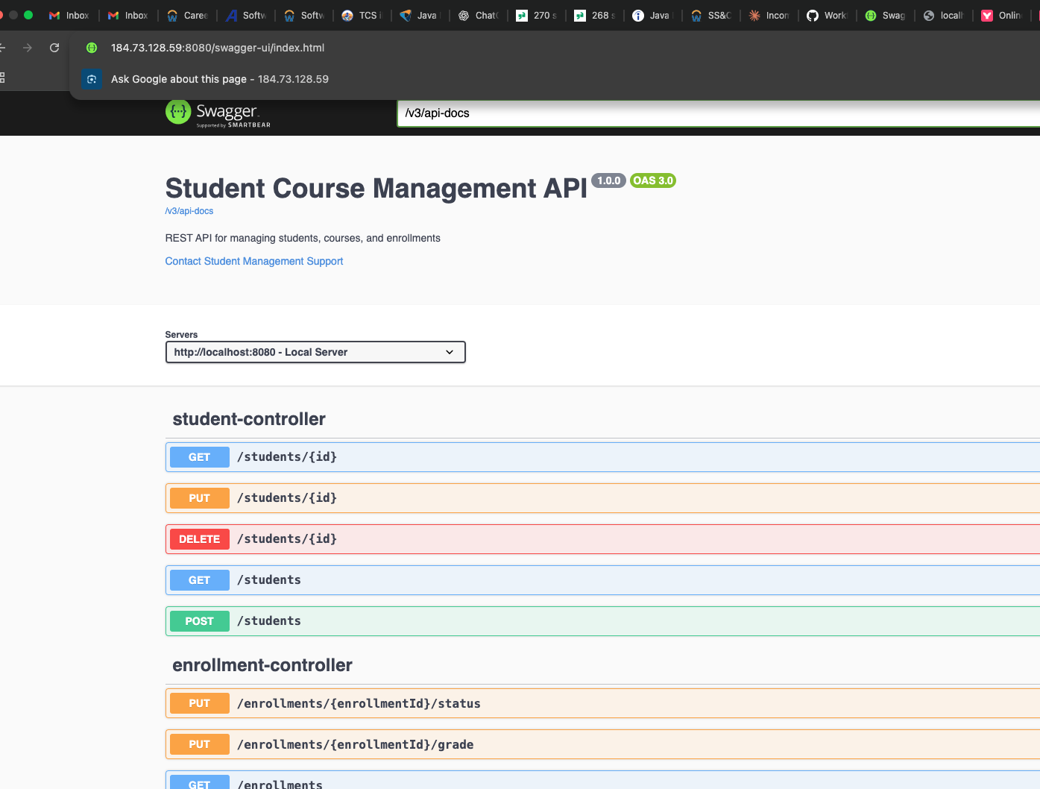
Swagger Accessed in AWS http://184.73.128.59:8080/swagger-ui/index.html

